Slide 1
Spiking Neural P system without delay simulator implementation using GPGPU
University of the Philippines Diliman:
Francis Cabarle
Henry Adorna
University of Seville:
Miguel Á. Martínez-del-Amor

Slide 2
Outline
Spiking Neural P systems (SNP)
Matrix representation
GPU computing
Simulation algorithm
Future work

Slide 3
SNP system definition
Π = (O, σ1 , . . . , σm , syn, in, out),
O = {a}, the singleton alphabet of spike a;
σi = (ni , Ri ), 1 ≤ i ≤ m, neurons, where:
  ni : initial number of spikes
  Ri : a finite set of rules
    spiking rule: E/a^{c} → a^{p}, E is a regular expression over a;
    forgetting rule: a^{s} → λ, for s ≥ 1;
syn, synapses between neurons;
in, out ∈ {1, 2, . . . , m}, the input and the output neurons.
A global clock is used in the synchronous systems.

Slide 4
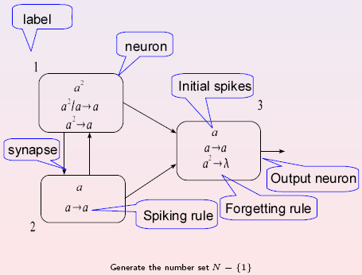
Simple example of SNP
Xiangxiang Zeng

Slide 5
Matrix representation
Previous work by Xiangxiang Zeng et al. presented in:
  X. Zeng, H. Adorna, M.A. Martínez-del-Amor, L. Pan. “When Matrices Meet Brains”, 8th BWMC.
  X. Zeng, H. Adorna, M.A. Martínez-del-Amor, L. Pan, M.J. Pérez-Jiménez. “Matrix Representation of Spiking Neural P Systems”, CMC11.

Slide 6
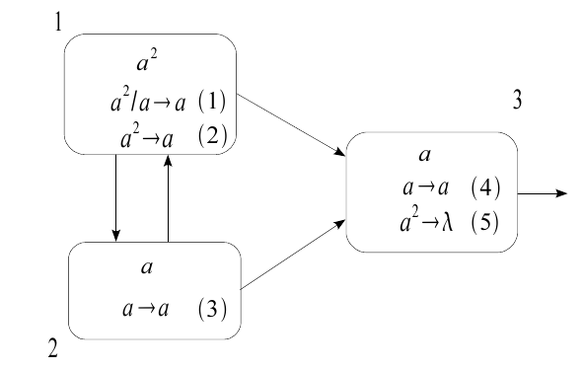
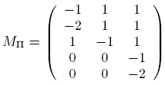
Matrix representation
Configuration vector (Ck): C0 = (2,1,1)
Spiking vectors (Sk): (1,0,1,1,0),(0,1,1,1,0)
Spiking transition matrix (MΠ):

Slide 7
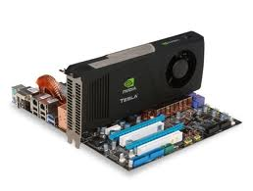
Matrix representation
Next configuration is calculated by:
Ck+1= Ck + Sk*MΠ
Matrix operations are very optimized on the GPU.
A GPU based simulator for SNP system.

Slide 8
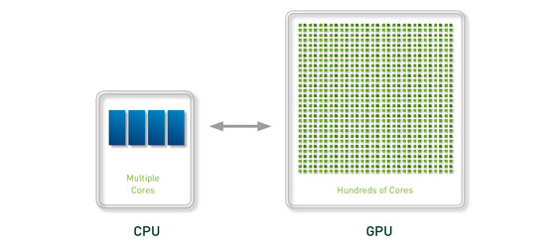
GPU computing
GPGPU: techniques for using the GPU as a massively parallel co-processor.
Host: the CPU vs Device: the GPU

Slide 9
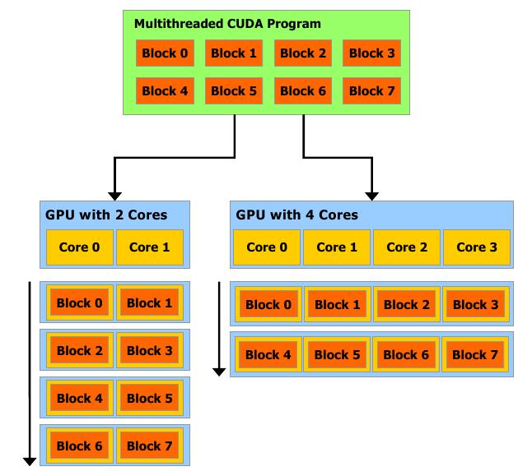

GPU computing: CUDA

Slide 10
Simulation algorithm
First version:
  Rules of type E/a^{c} → a^{p} where E=a^{c}
  Simulation of non-determinism
Two stopping criteria:
  Zero configuration vector
  Repetition of configuration vectors
Host side (python/C):
  Read/write matrices and calculate spiking vectors
Device side (CUDA):
  Matrix addition and multiplication
Notes:
* Repetition of configuration vectors => to prevent infinite loops.
* Host side (python/C):
=> Python (OOP language) for string manipulations.
=> produce All possible and valid spiking vectors
* Device side (CUDA):
=> outsourcing of highly repetitive work

Slide 11
Simulation algorithm
Overview:
  Load inputs (Host):
    Configuration vector: confVec
    Transition matrix: M
    Rule criteria: r
  Calculate all spiking vectors (Host):
    All possible spikVec from all configurations confVec
  Calculate next configurations (Device):
    For each spiking vector, calculate the next configurations.
  Repeat I, II and III until stopping criteria satisfies.
Notes:
II. => produce All possible and valid spiking vectors.
Σ = |r|, total number of neurons
Ψ = |σV 1 ||σV 2 |...|σV n |, n ∈ N, n ≤ ∞
Where |σV n | means the total count of the number of rules in the nth neuron which satisfy the regular expresion E. Ψ gives the expected number of valid and possible Sks which should be produced in a given configuration.

Slide 12
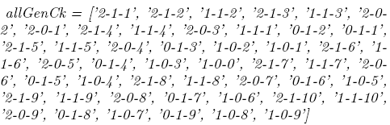
Output of the simulator
The list of all possible configurations Ck
Notes:
All possible Ck, else, infinite loops (as seen in the configuration tree next)

Slide 13
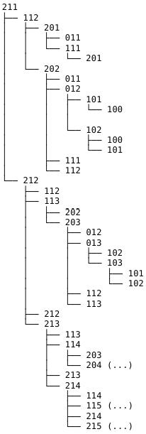
Output of the simulator
Tree of configurations:

Slide 14
Future work
To automatically generate the graphical tree of configurations.
More general regular expressions.
Simulate SNP system with delay.
Backwards computation.
Improve the CUDA code performance:
  Byte-compiling the python code.
  Use optimized algorithms for matrix multiplication.
Notes:
* Use optimized algorithms for matrix multiplication => work on optimized algorithms for sparse matrix operations applied to GPGPUs

Slide 15
THANKS FOR YOUR ATTENTION

